Slide 2
Authentic love
Goes to the core of one’s heart
Rooted in the person and love of God for mankind
Encourages love
In marriages and all Christian love
Not “in love” like a modern romance novel/movie
A picture of love & sex that collides with our culture’s ideas

Slide 3
Can’t read this book and not see us and the Lord’s love for us
Luke 10:27
2 Corinthians 11:2
Song of Solomon 5:16 & John 15:15

Slide 4
Song of Solomon 8:6–7
“Put me like a seal over your heart,
Like a seal on your arm.
For love is as strong as death,
Jealousy is as severe as Sheol;
Its flashes are flashes of fire,
The very flame of the Lord.
“Many waters cannot quench love,
Nor will rivers overflow it;
If a man were to give all the riches of his house for love,
It would be utterly despised.”

Slide 5
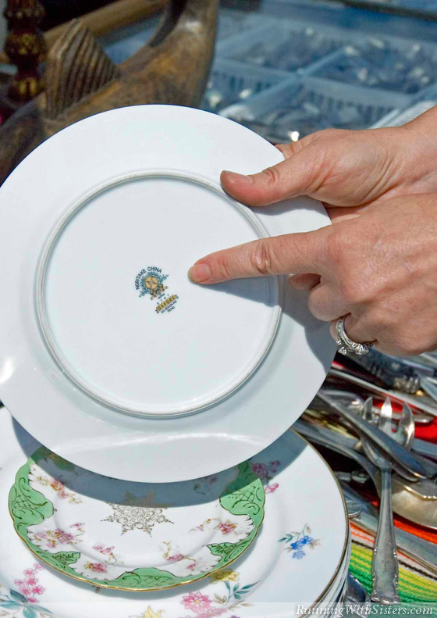

Slide 6
Seal—literally, a cylinder worn on a necklace underneath clothing
She wants his seal to mark her heart; permanent identity and possession
She wants to be the seal on his heart
Permanence of married love
On arm—protector and deliverer
Seal—spiritually fulfilled in us by the Holy Spirit

Slide 7
Strong as death
Love that is unbreakable
Love that can’t be stopped or undone or cancelled

Slide 8
Jealous
Crushing power of jealousy (Count of Monte Cristo)
Against anything that could come between me and love for Christ
God’s jealousy for us

Slide 9
Waters
Nothing can quench this kind of love
Romans 8:38–39: For I am convinced that neither death, nor life, nor angels, nor principalities, nor things present, nor things to come, nor powers, nor height, nor depth, nor any other created thing, will be able to separate us from the love of God, which is in Christ Jesus our Lord.
Riches
This love cannot be bought or sold
Sex can be bought; love must be given

Slide 10
We idolize and romanticize love
There’s true hope for this kind of real, deep love in our marriages
Some need to know about the passion of God’s love because he seems so harsh or distant
God’s love is for you and that’s how he draws people to Himself
This scripture is the heart-cry love language of the believer
Love God like this
He’s not interested in law keepers; he wants us a loving Bride!

Slide 11
Hi-5 Promotion Party
and Parent Meeting
August 23rd
For more information, email info@tsf-church.com

Slide 12
End of Summer Party
August 25th at Matt Prine’s house
For more info and to sign up, go to fb.com/tsfrefuge
or email matt@tsf-church.com.

Slide 13
LADIES BIBLE STUDY
Begins September 14th
Several options to choose from! Sign up today!

