Slide 1
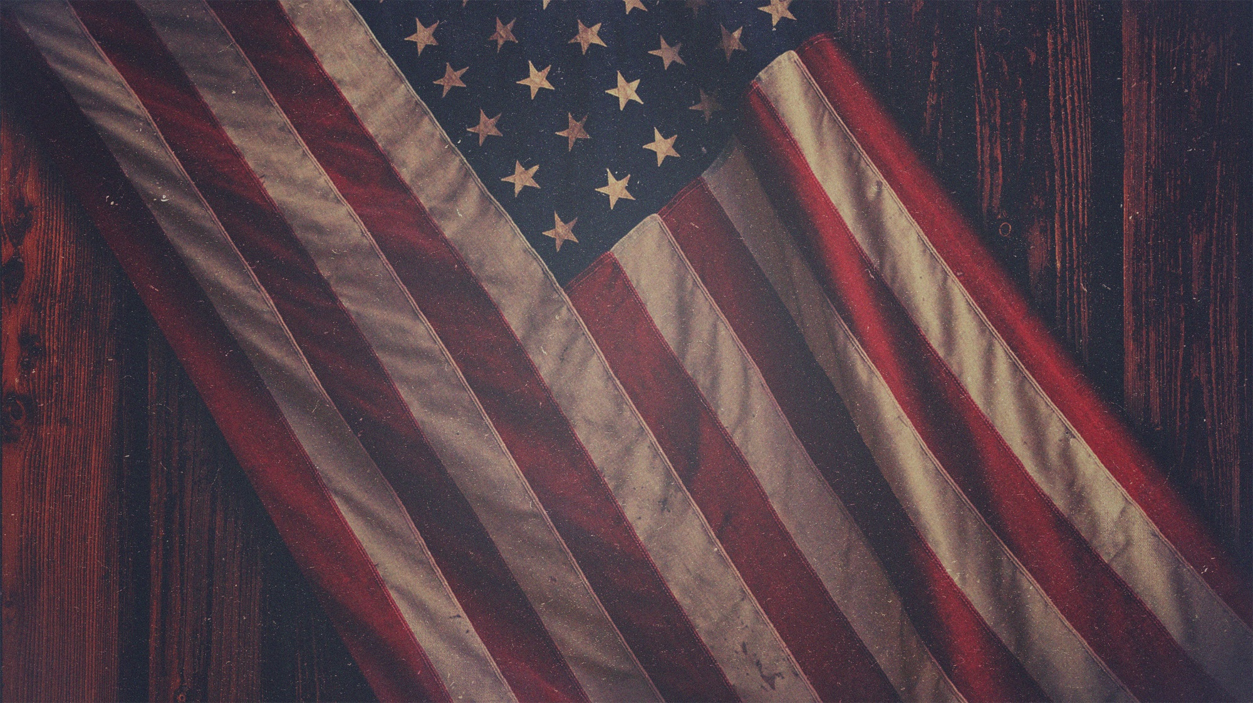
Gospel Living
in a
Changing World
7.5.15
1 Peter 2:11-25

Slide 2
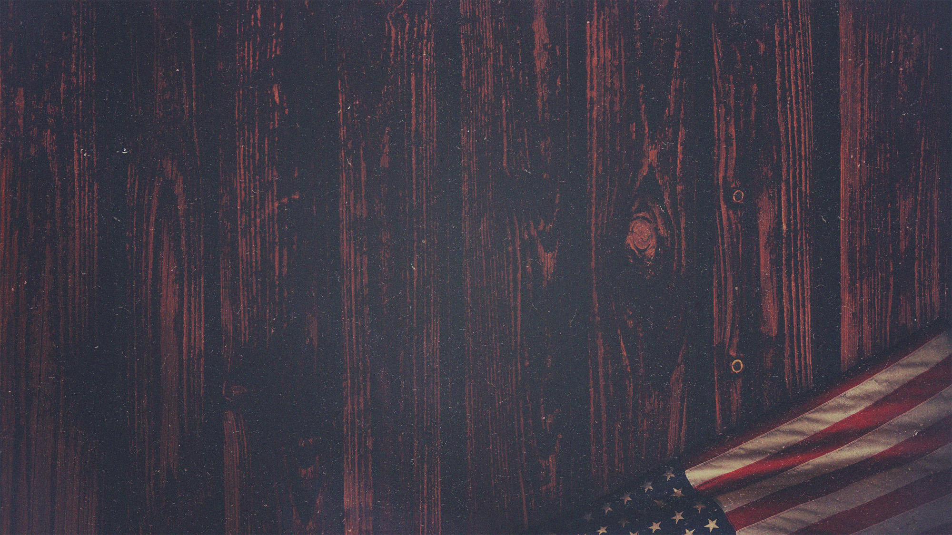
What are we to believe? We start with the Bible as being authoritative
Inspired, inerrant, infallible (2 Timothy 3:16; Hebrews 4:12)
Homosexuality is a sin (both the act and the orientation)
Gen. 1&2; Gen. 19; Lev. 18; Lev. 20; 1 Cor. 6; 1 Cor. 1; Rom. 1
Matthew 19:4-6: this is Jesus speaking on gender and marriage
Sexuality and gender is sacred

Slide 3
ERLC.com

Slide 4
11 Beloved, I urge you as aliens and strangers to abstain from fleshly lusts which wage war against the soul. 12 Keep your behavior excellent among the Gentiles, so that in the thing in which they slander you as evildoers, they may because of your good deeds, as they observe them, glorify God in the day of visitation.

Slide 5
We are aliens
Do we live like this or are we living for acceptance?
The first place of judgment is the house of God
2. Do you hate the sin in your own heart? (1 Peter1:16)
3. Are we participating in our culture’s demise?
4. Will we do the supernatural?

Slide 6
13 Submit yourselves for the Lord’s sake to every human institution, whether to a king as the one in authority, 14 or to governors as sent by him for the punishment of evildoers and the praise of those who do right. 15 For such is the will of God that by doing right you may silence the ignorance of foolish men. 16 Act as free men, and do not use your freedom as a covering for evil, but use it as bondslaves of God. 17 Honor all people, love the brotherhood, fear God, honor the king.

Slide 7
The Church persecuted is not unique
Christians under Claudius or Nero; “be subject to the emperor; it’s God’s will”
2. The Church in America is unique
A democratic republic; we vote for representatives!
173 million professing Christians in US!
3. Government is a God-given authority with limits
For the restraint of evil and the promotion of good (Manhattan Declaration)

Slide 8
4. We are free servants of God
We resist a government that requires evil because we fear God
We respect the law that applies and resist the ones that promote evil
5. We fear God
We live for and with God, loving and obeying him
Not fear of man or government

Slide 9
21 For you have been called for this purpose, since Christ also suffered for you, leaving you an example for you to follow in His steps, 22 who committed no sin, nor was any deceit found in His mouth; 23 and while being reviled, He did not revile in return; while suffering, He uttered no threats, but kept entrusting Himself to Him who judges righteously; 24 and He Himself bore our sins in His body on the cross, so that we might die to sin and live to righteousness; for by His wounds you were healed. 25 For you were continually straying like sheep, but now you have returned to the Shepherd and Guardian of your souls.

Slide 10
We follow Christ in suffering.
We never back away from confronting sin and loving people.
We live and speak like God is sovereign and good.

Slide 11
What do we not do?
Stay in the sin and lies of prosperity gospel
Correlate America to God’s Kingdom
Force Jesus into a political cause
Cave in
Stay the same
Panic

Slide 12
What do we do?
Use legal means and the system to undo evil
Article 3, Section 2 of the Constitution
“The majority’s decision is an act of will, not a legal judgment.”
– Chief Justice Roberts
Speak prophetically
Feel weird
“My eyes have shed streams of tears, because people do not keep Your law.” (Psalm 119:136)
Live for the gospel
Stand for those who cannot stand for themselves
Love, shepherd, and teach
Pray and repent

Slide 13
God bless America
Land that I love
Stand beside her and guide her
Through the night with the light from above
From the mountains to the prairies
To the oceans, white with foam
God bless America
My home, sweet home
God bless America
My home, sweet home

