Slide 1
Wisdom in Suffering
Psalm 69

Slide 2
Suffering is universal for humanity
That suffering can be due to several things.
Loss of a loved one
Failure
Illness
Injury from those around us
Our own mistakes/bad decisions
Wisdom affects how we deal with suffering

Slide 3
INTERNET SUGGESTIONS - How to stop your suffering in the next five minutes.
Make a list of negative emotions.
Make a list of attachment to desires.
Connect your negative emotions to your list of desires.
Realize that nothing lasts.
Contemplate getting all of your desires.
By now you should be feeling better.

Slide 4
INTERNET SUGGESTIONS
Meditate
Paradise-Engineering - David Pearce
WikiHow - How to stop suffering in silence

Slide 10
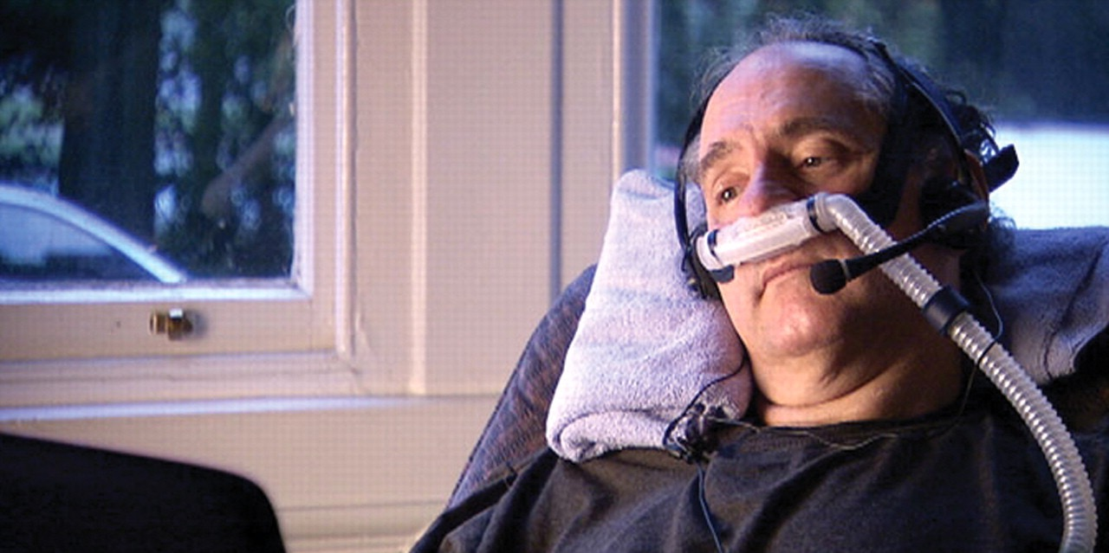
Craig Ewert - The suicide tourist

Slide 11
“If I go through with it [assisted suicide], I die, as I must at some point. If I don't go through with it, my choice is essentially to suffer and to inflict suffering on my family, and then die, possibly in a way that is considerably more stressful and painful than this way. I've got death. I've got suffering and death. Well gee, you know, this makes a whole lot of sense to me.”
- Craig Ewert

Slide 12
Suffering is a reality that we all must face
Scripture confirms this
1 Peter 4:12
1 Peter 5:9
Romans 5:3
many others

Slide 13
Suffering has purpose
It can accomplish things in us that could be accomplished no other way
2 Corinthians 4:17-18 - For this light momentary affliction is preparing for us an eternal weight of glory beyond all comparison, as we look not to the things that are seen but to the things that are unseen. For the things that are seen are transient, but the things that are unseen are eternal.

Slide 14
Suffering for a Christian
Psalm 69 - Wisdom in Suffering
Come with Desperation
Come with Confession
Come with Passion
Come Pleading for Rescue
Come with Praises

Slide 15
Psalm 69:1-4
[1] Save me, O God! For the waters have come up to my neck. [2] I sink in deep mire, where there is no foothold; I have come into deep waters, and the flood sweeps over me. [3] I am weary with my crying out; my throat is parched. My eyes grow dim with waiting for my God. [4] More in number than the hairs of my head are those who hate me without cause; mighty are those who would destroy me, those who attack me with lies.
What I did not steal must I now restore?

Slide 16
COME WITH DESPERATION
The pain of suffering compared to drowning or being caught in quick-sand
Be desperate for the Lord to move, because if He doesn’t, there’s no hope.
Cry out relentlessly
In the midst of this anguish, it is appropriate for a Christ-follower to cry out to God in desperation.
Cry out until your throat is parched & eyes weary.
Offer up genuine and raw cries

Slide 17
Psalm 69:5-6
[5] O God, you know my folly; the wrongs I have done are not hidden from you. [6] Let not those who hope in you be put to shame through me, O Lord GOD of hosts; let not those who seek you be brought to dishonor through me, O God of Israel.

Slide 18
COME WITH CONFESSION
Sometimes we suffer because of our own choices
Be quick to go to the Lord in confession
There is a confidence in the heart of a Christ-follower who goes to the Lord in confession.
Confession helps us to hear from the Lord
Concern for others not to be shamed
Others observe our response in the midst of suffering.
Pray that God would use our suffering.
2 Corinthians 1:3-7

Slide 19
Psalm 69:7-12
[7] For it is for your sake that I have borne reproach, that dishonor has covered my face. [8] I have become a stranger to my brothers, an alien to my mother's sons. [9] For zeal for your house has consumed me, and the reproaches of those who reproach you have fallen on me. [10] When I wept and humbled my soul with fasting, it became my reproach. [11] When I made sackcloth my clothing, I became a byword to them. [12] I am the talk of those who sit in the gate, and the drunkards make songs about me.

Slide 20
COME WITH PASSION
Pursue God’s glory above all things
This could (maybe most likely) lead to more suffering
God’s glory is more important than your comfort.
We may endure, disgrace, dishonor, disownment from family, mourning, mockery…
God’s actions are primarily about God’s glory rather than the relief of suffering for the saint.

Slide 21
Psalm 69:13-18
[13] But as for me, my prayer is to you, O LORD. At an acceptable time, O God, in the abundance of your steadfast love answer me in your saving faithfulness. [14] Deliver me from sinking in the mire; let me be delivered from my enemies and from the deep waters. [15] Let not the flood sweep over me, or the deep swallow me up, or the pit close its mouth over me. [16] Answer me, O LORD, for your steadfast love is good; according to your abundant mercy, turn to me.
[17] Hide not your face from your servant;
for I am in distress; make haste to answer me.
[18] Draw near to my soul, redeem me; ransom
me because of my enemies!

Slide 22
COME PLEADING FOR RESCUE
Make your requests known to the Lord.
The Lord is able
C.H. Spurgeon - Put up a variety of requests without fear of exceeding our liberty to ask, or His ability to answer.
David asks for delivery from the mire and flood.
But, asks that it not sweep over him.

Slide 23
The bigger and more important thing than the suffering being removed, is the Lord being with me.
In the midst of suffering, the thing we need more than relief from that suffering is the knowledge that He is with me - and that He empathizes with me.

Slide 24
Psalm 69:19-28
[19] You know my reproach, and my shame and my dishonor; my foes are all known to you. [20] Reproaches have broken my heart, so that I am in despair. I looked for pity, but there was none, and for comforters, but I found none. [21] They gave me poison for food, and for my thirst they gave me sour wine to drink. [22] Let their own table before them become a snare; and when they are at peace, let it become a trap.

Slide 25
Psalm 69:19-28
[23] Let their eyes be darkened, so that they cannot see, and make their loins tremble continually. [24] Pour out your indignation upon them, and let your burning anger overtake them. [25] May their camp be a desolation; let no one dwell in their tents. [26] For they persecute him whom you have struck down, and they recount the pain of those you have wounded. [27] Add to them punishment upon punishment; may they have no acquittal from you. [28] Let them be blotted out of the book of the living;
let them not be enrolled among the righteous.

Slide 26
Psalm 69:29-36
[29] But I am afflicted and in pain; let your salvation, O God, set me on high! [30] I will praise the name of God with a song; I will magnify him with thanksgiving. [31] This will please the LORD more than an ox or a bull with horns and hoofs. [32] When the humble see it they will be glad; you who seek God, let your hearts revive. [33] For the LORD hears the needy and does not despise his own people who are prisoners. [34] Let heaven and earth praise him, the seas and everything that moves in them. [35] For God will save Zion and build up the cities of Judah, and
people shall dwell there and possess it; [36]
the offspring of his servants shall inherit it,
and those who love his name shall dwell in it.

Slide 27
COME WITH PRAISES
Only the Christ-follower can say: “Despite the pain and fiery trial, Lord let Your salvation set me on high!”
Hebrew - inaccessibly high
Suffering will not have the final say
Salvation is a guarantee of the end of suffering - in eternal life

Slide 28
The appropriate response is to praise His name.
Sing to the Lord from the midst of the fire.
How to praise the Lord - Give Him your heart!
Let your heart be filled with hope that you are not forgotten.
As you suffer, run to the Lord!
Come with desperation, confession, passion, pleading for rescue, and praise!

