Slide 1
The Truth about Worship
Revelation 4 and 5; Isaiah 29:13

Slide 2
We want to shift our focus away from us, from self-worship, and to worshiping the proper recipient
Our time, message, and lyrics are designed to redirect your daily lives into true worship
3 questions:
1 - What is worship?
2 - What am I worshiping?
3 - What does worship look like?

Slide 3
What is worship?
First, know that God doesn’t need our worship
“Worship is the believer’s response of all that they are - mind, emotions, will, body - to what God is and says and does.” (Weirsbe)
The fullest love is when you express love (Lewis)
God loved us & expressed it in Christ - on the cross
Are we expressing our love fully to God?

Slide 4
Revelation 4:8, 11
⁸ And the four living creatures, each one of them having six wings, are full of eyes around and within; and day and night they do not cease to say, “Holy, holy, holy is the Lord God, the Almighty, who was and who is and who is to come.” […] ¹¹ “Worthy are You, our Lord and our God, to receive glory and honor and power; for You created all things, and because of Your will they existed, and were created.”

Slide 5
Revelation 5:6, 9
⁶ And I saw between the throne (with the four living creatures) and the elders a Lamb standing, as if slain, having seven horns and seven eyes, which are the seven Spirits of God, sent out into all the earth. […] ⁹ And they sang a new song, saying, “Worthy are You to take the book and to break its seals; for You were slain, and purchased for God with Your blood men from every tribe and tongue and people and nation.

Slide 6
What am I worshiping?
1) Man was created to worship God
The fall of man into sin so that we marvel at and obsess over and worship the wrong things
2) We instinctually worship what brings us the most joy (what we believe or want to bring us the most joy)
We confuse beautiful things here for true beauty and we desire them, then worship them

Slide 7
What does worship look like?
there are barriers to worship:
Schaeffer: Personal peace and prosperity
Chandler:
Money and comfort
Relationships and sex
Respect and success

Slide 8
Isaiah 29:13
Then the Lord said,
“Because this people draw near with their words And honor Me with their lip service, But they remove their hearts far from Me, And their reverence for Me consists of tradition learned by rote,

Slide 9
Worship always includes action but….
It also includes our heart: feelings and emotions
What are we aiming for in our hearts in worship?
A deep joy that needs to say and do something!
My mind, heart, will, emotions all have to be moved - the trajectory of our lives must be changed!

Slide 10
Corporate Worship:
God is Ultimate
God is Primary
God is Beautiful

Slide 11
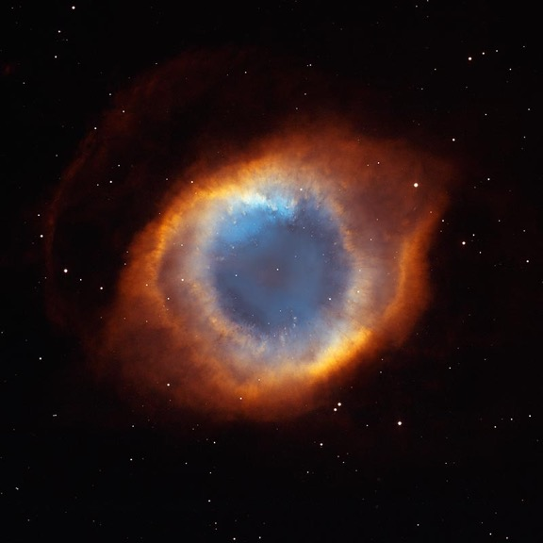

Slide 12
Corporate Worship:
God is Ultimate
God is Primary
God is Beautiful
God is Love
God is Just
Jesus is God (known/experienced through the Spirit)

Slide 13
What is your worship like?
A response of all that you are to God?
Is the trajectory of your life changed?

Slide 14
Who are you worshiping?
what do you obsess over?
What have you ascribed worth to in your time: relationships, choices, dreams, families?

Slide 15
What does our corporate worship look like?
Moving you from self-worship to God-centered worship
Challenging the mind, stirring the emotions, changing the trajectory of life
Jesus focused

Slide 16
Psalm 96:6-8
⁶ Splendor and majesty are before Him, Strength and beauty are in His sanctuary.
⁷ Ascribe to the Lord, O families of the peoples, Ascribe to the Lord glory and strength. ⁸ Ascribe to the Lord the glory of His name; Bring an offering and come into His courts.

