Slide 1
Free for Freedom
Galatians 5:1-12

Slide 2
We can live and hope in our efforts to be good and to get to God (Law)
We can live and hope in Christ to make us good and to get us to God (Grace)
When we talk about freedom, there are conflicting responses:
Some hear freedom & joy
Others hear limits and restrictions - where is the freedom?

Slide 3
Love and marriage brings a lot of freedom, but at the expense of other freedoms
“To experience the joy and freedom of love, you must give up your personal autonomy.” Keller
We are created to live in freedom as creatures who know the Creator as Father
“Freedom, then, is not the absence of limitations and constraints, but it is finding the right ones, those that fit our nature and liberate us.” Keller

Slide 4
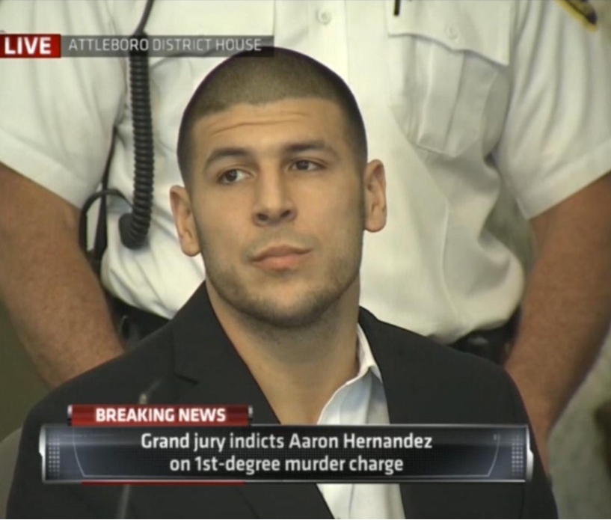

Slide 5
Galatians 5:1
It was for freedom that Christ set us free; therefore keep standing firm and do not be subject again to a yoke of slavery.

Slide 6
Luke 4:18
“The Spirit of the Lord is upon Me,
Because He anointed Me to preach the gospel to the poor.
He has sent Me to proclaim release to the captives,
And recovery of sight to the blind,
To set free those who are oppressed,

Slide 7
To help us better understand freedom in Galatians, let’s see what Jesus said about it
“favorable year of our Lord…”
Time of the Messiah, could be year or years
Riches for the spiritually poor (Genesis 18:27)
Sight for the spiritually blind (2 Cor. 4:4)
Freedom for those oppressed by sin (Galatians 5:1)

Slide 8
At the heart of this freedom is a fundamental change in relationship with God - from slave to son
Slave to:
Sin Flesh Satan Pride Effects of sin Law
Will you choose to leave here today a slave or a son?

Slide 9
Galatians 5:2-6
² Behold I, Paul, say to you that if you receive circumcision, Christ will be of no benefit to you. ³ And I testify again to every man who receives circumcision, that he is under obligation to keep the whole Law. ⁴ You have been severed from Christ, you who are seeking to be justified by law; you have fallen from grace. ⁵ For we through the Spirit, by faith, are waiting for the hope of righteousness. ⁶ For in Christ Jesus neither circumcision nor uncircumcision means anything, but faith working through love.

Slide 10
Circumcision and the law
If you’re going to be a really good Christian, be a law keeper
Ceremonial law given to physically separate Jews and others (hair, clothes, food, etc)
No more - the thing that separates us now is the Spirit

Slide 11
The danger of keeping the law:
Feeds my pride
Separates me from God
Presents a false gospel to others in slavery
Places me in an impossible eternal loop

Slide 12
We have the hope of righteousness:
Daily, intense desire and expectation of practical and eternal righteousness
It’s not works – it’s faith through love
Faith accepts the challenge of living morally in order to see God work in our hearts and show His power and glory in us
Faith allows us to work hard through love

Slide 13
Galatians 2:7-12
⁷ You were running well; who hindered you from obeying the truth? ⁸ This persuasion did not come from Him who calls you. ⁹ A little leaven leavens the whole lump of dough. ¹⁰ I have confidence in you in the Lord that you will adopt no other view; but the one who is disturbing you will bear his judgment, whoever he is. ¹¹ But I, brethren, if I still preach circumcision, why am I still persecuted? Then the stumbling block of the cross has been abolished. ¹² I wish that those who are troubling you would even mutilate themselves.

Slide 14
Grace isn’t just a pretty idea in a song – it’s wrapped in the cross
Paul says it’s a good thing the cross is a stumbling block
It either makes you elated because your sins are forgiven or…
Irrationally angry because I can’t boast in how good I am

Slide 15
Galatians 2:11-12
¹¹ But I, brethren, if I still preach circumcision, why am I still persecuted? Then the stumbling block of the cross has been abolished. ¹² I wish that those who are troubling you would even mutilate themselves.

Slide 16
Our works apart from faith don’t impress God, they offend Him - why?
They are rooted in our sin
They reject His grace

Slide 17
Freedom:
“…to pursue the highest level of pleasures…”
Failure doesn’t mean rejection - it brings the promise of forgiveness!
From the cruel lords that I measure myself against
“…significance, security, and affirmation…” from the Author of love
STAND FIRM!!

